Slide 1
Digital slide seminar - liver pathology
Ítalo Costa das Neves
Advised by Dr. Prof. Luiz Antônio Rodrigues de Freitas
Faculdade de Medicina da Bahia (UFBA – Universidade Federal da Bahia)

Slide 2
Conflict of Interest Statement
The authors certify that they have NO affiliations with or involvement in any organization or entity with any financial interest or non-financial interest in the subject matter or materials discussed in this presentation.
Requirement of ANVISA RDC No. 96/08

Slide 3
Case Presentation
DSS, female, 34 years old
Past medical history of insulin-dependent DM (onset at 22 years old), without adequate control + hypertension
Chief complaint:
Edema of the lower limbs for 6 months, progressing to anasarca
Other current complaints:
Pain in the upper quadrant of the abdomen radiating to the back
Nausea and vomiting
Upon hospitalization: anemia + proteinuria in the nephrotic range + marked elevation of hepatocellular and canalicular enzymes
In irregular use of Losartan (100 mg/dia), Hydrochlorothiazide (25 mg/dia), Anlodipine (10 mg/dia), Metformin XR (500 mg/dia), Insulin NPH (20-0-0-10).

Slide 4
Case Presentation
Physical examination:
Vitals: HR 112 bpm |RR 18 | BP 141 x 87 mmHg | weight 67 kg | height 1,48m | BMI 30,59
General Appearence: No signs of discomfort or distress are observed;
Respiratory: Lungs are clear to auscultation bilaterally. No wheezes, rales, or rhonchi. Chest wall is non-tender with normal respiratory effort;
Cardiovascular: Heart sounds are normal with a regular rate and rhythm. No murmurs, rubs, or gallops are heard. Peripheral pulses are 2+ and symmetric;
Abdomen: Abdomen is globose due to adipose tissue. Bowel sounds are present. There is tenderness on palpation in the right hypochondrium. The liver is palpable 3 cm below the right costal margin. No ascites is detected.
Ophthalmic examination: Severe proliferative diabetic retinopathy bilaterally. Grade III hypertensive retinopathy

Slide 5
Labs
 | 26/12/23 | 13/01/24 | 26/02/24 | 01/03/24 | 06/03/24 | 15/03/24 | 08/04/24
HB | 11,4 | 10,0 | 6,7 | 8,1 | 8,8 | 7,4 | 9,5
HT | 35,2% |  | 22% | 26,1% | 27,7% | 22,8% | 28,2%
HbA1c | 12,4% |  |  |  |  | 5,2%
Leuco | 6.130 | 10.820 | 5.190 | 6.060 | 5.920 | 4.510 | 6.090
Platelet | 283.000 | 465.000 | 463.000 | 398.00 | 458.000 | 456.000 | 341.000
NA |  | 133 | 144 | 144 | 143 | 144 | 141
K | 3,78 | 2,9 | 3,7 | 4,1 | 3,9 | 3,6 | 4,6
Urea | 30 | 53 | 48 | 36 | 41 | 44 | 51
Creatinine | 0,9 | 0,7 | 0,6 | 0,7 | 0,8 | 1,1 | 1,2
LDL | 350 |  |  |  |  |  | 266
HDL | 56 |  |  |  |  |  | 53
Triglyc. | 360 |  |  |  |  |  | 233
BT | 0,2 | 0,1 |  |  | 0,28 |  | 0,17
Lipase |  | 28 |  |  | 9
Amylase |  | 31 |  |  | 26
AST | 14 | 27 | 131 | 231 | 69 | 20 | 25
ALT | 18 | 30 | 108 | 184 | 121 | 37 | 27
ALP | 149 | 86 | 475 | 588 | 716 | 653 | 496
GGT |  | 98 | 1.400 | 4.383 | 3.687 | 3.804 | 3.230
NRI |  |  |  |  | 0,9
TTPA |  |  |  |  | 41,3

Slide 6
Labs
Exames | Resultados
Urinalysis | Prot. (+++), gluco (+++), Hb (+++)
Anti-mitochondria, Anti-smooth muscle, ANCA, Anti-DNA, Anti-SSA (Ro), Anti-SSB(La), Anti-Cardiolipin IgG/IgM, C3, FAN, Rheumatoid factor, Anti-TG, Anti-TPO, Anti-HIV, Anti-HCV, AgHBs, VDRL | Unaltered
USG, CT and MRI of the whole abdomen CPRM, EDA and colonoscopy | Unaltered

Slide 7
Clinical overview
Female
34 years old
Hypertension and insulin-dependent DM without adequate control
Anasarca, abdominal pain, hepatomegaly, nausea and vomiting
Anemia, dyslipidemia, proteinuria, hematuria, glycosuria, elevated hepatocellular and canalicular enzymes
Metabolic Dysfunction-Associated Steatotic Liver Disease (MASLD)?
LIVER BIOPSY INDICATED
Drug-Induced Liver Injury (DILI)?
Autoimmune hepatites (AIH)?
Notes:
Pq biopsia?
Esteato hepatite
Hepatite autoimune
dily

Slide 8
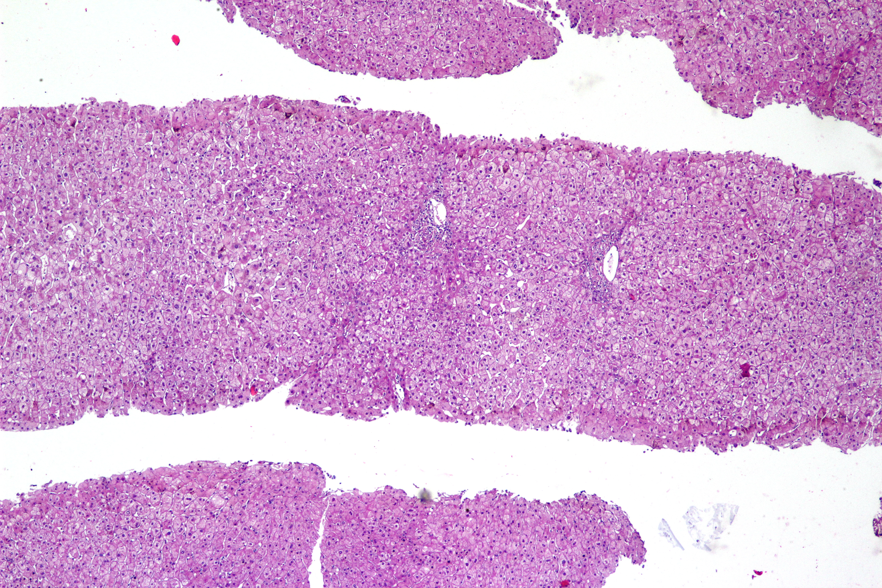
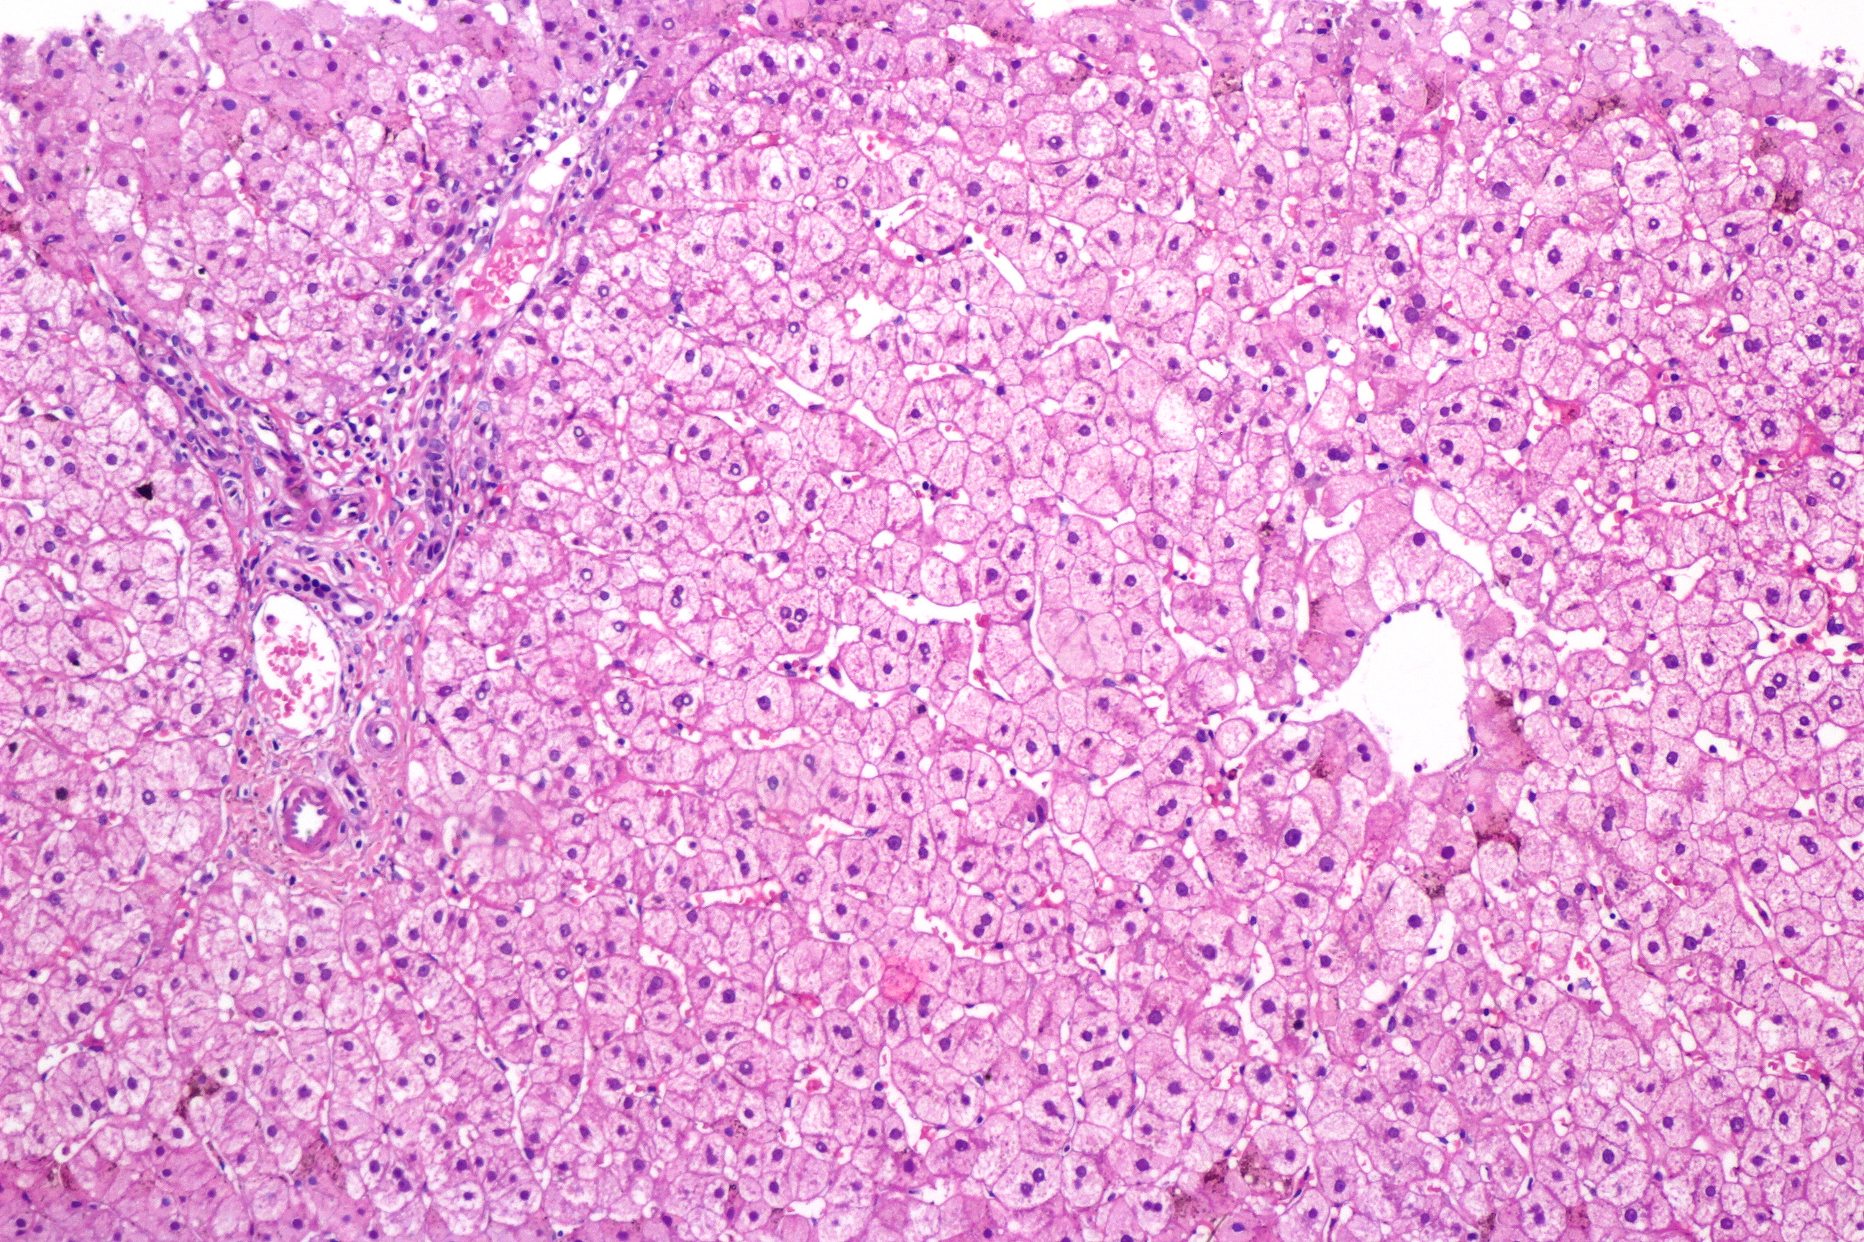
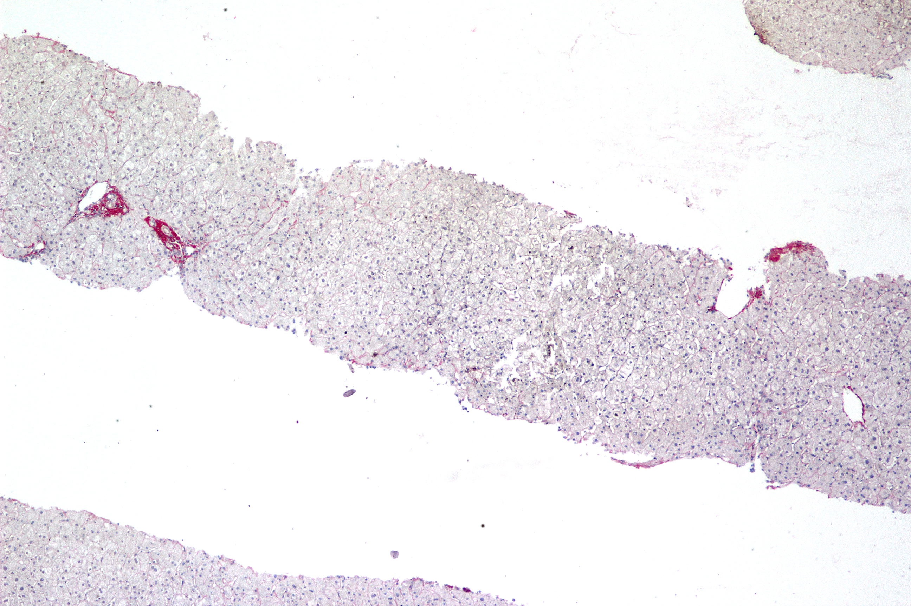
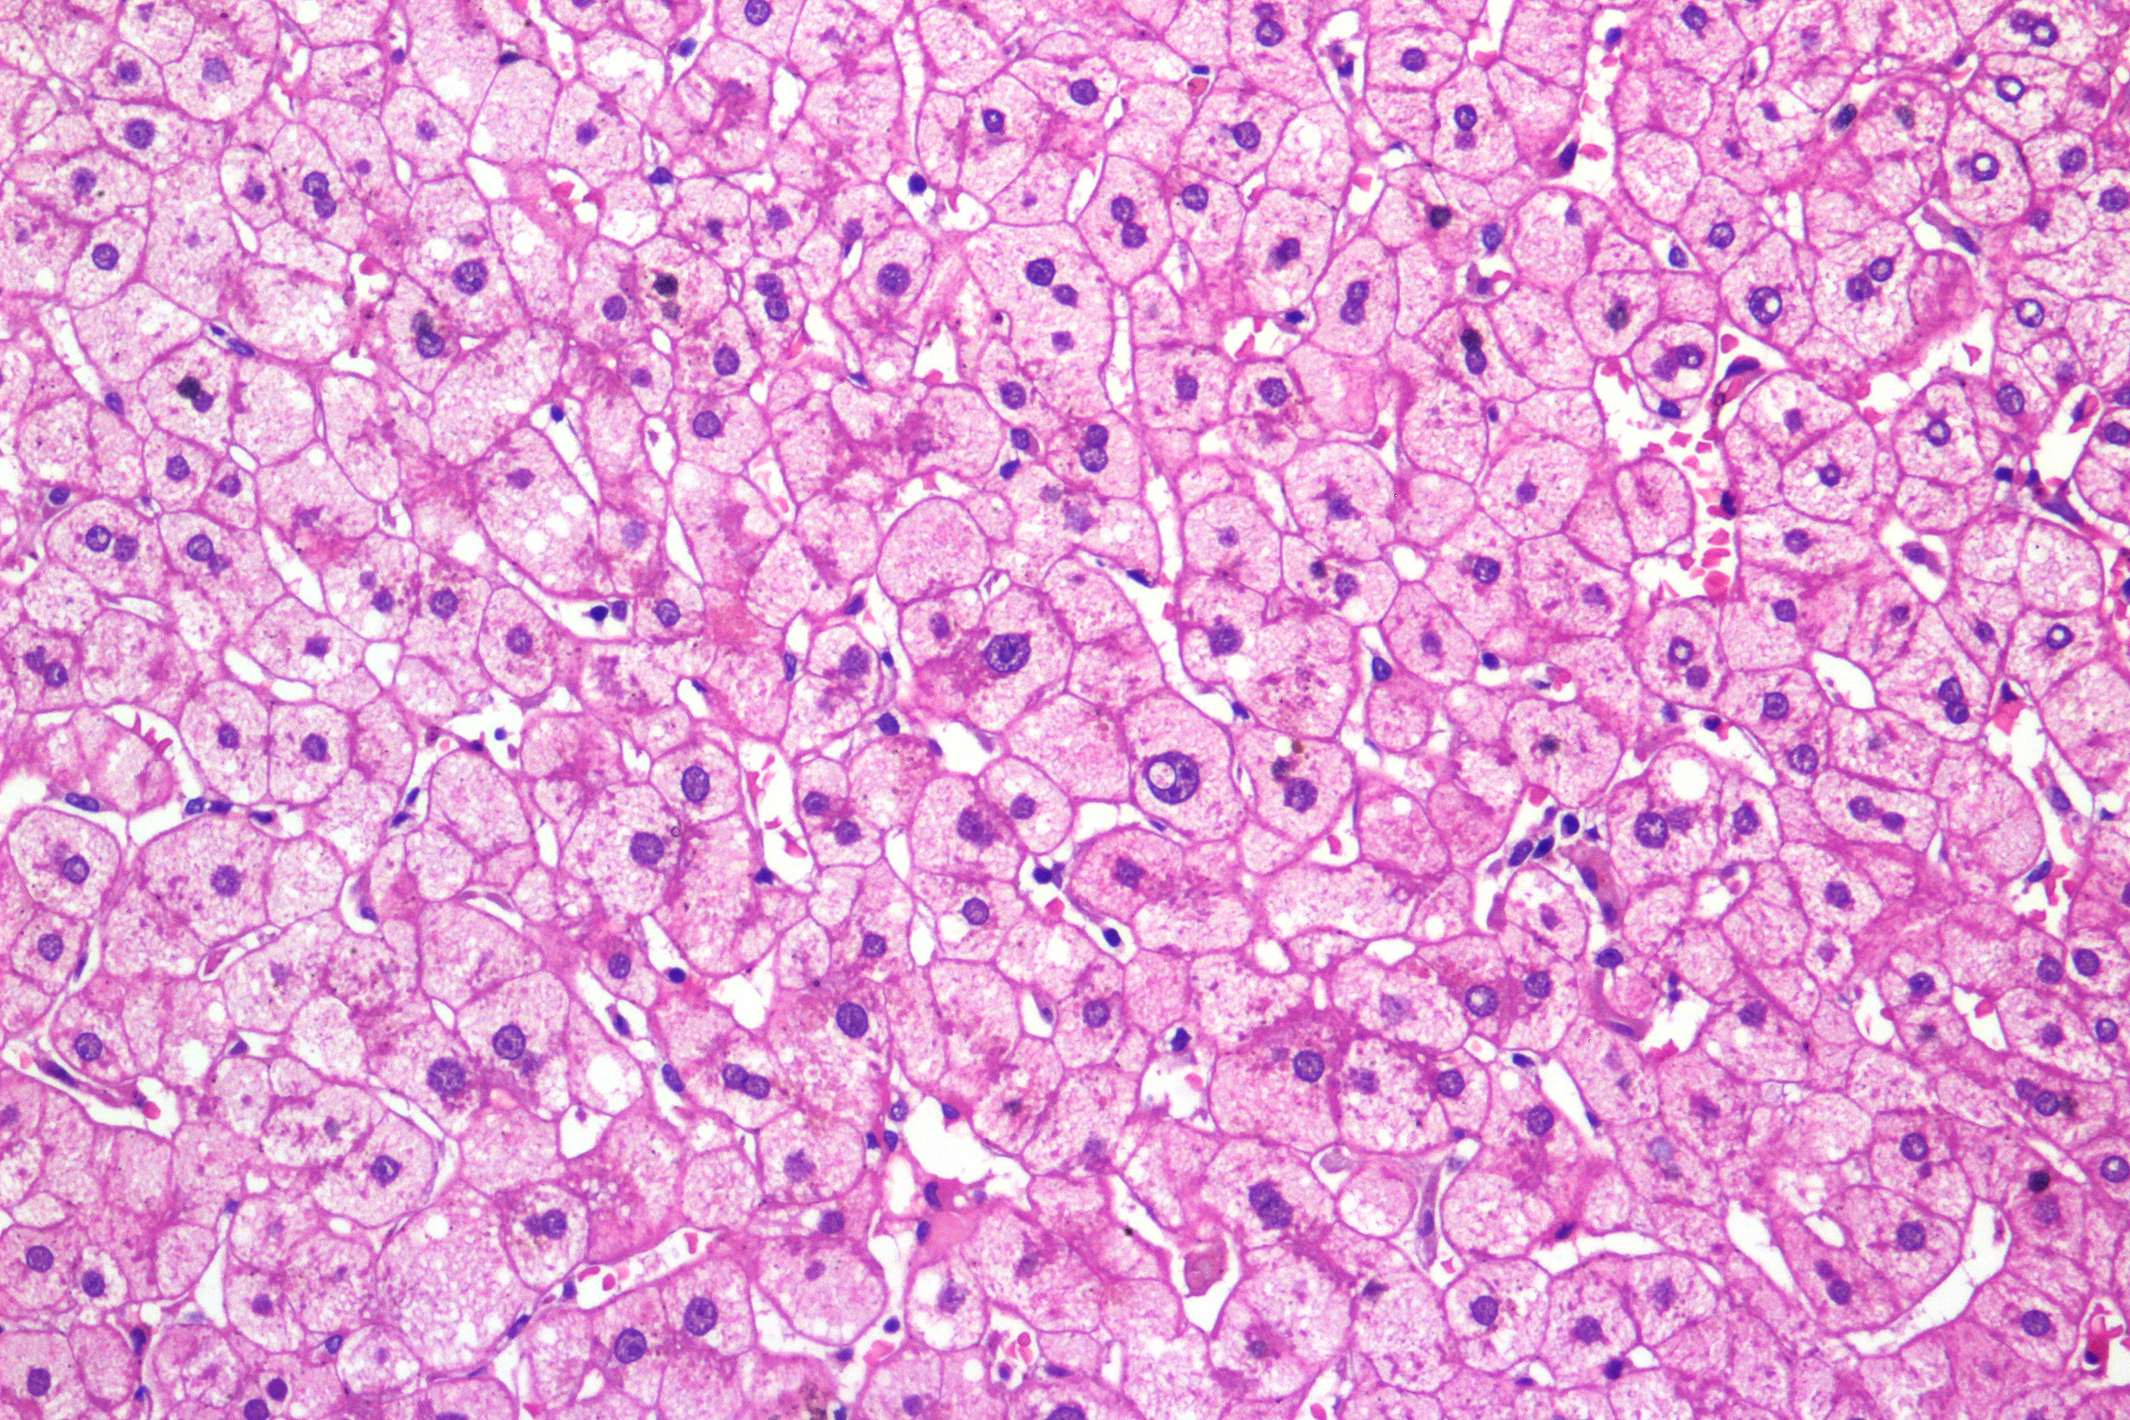
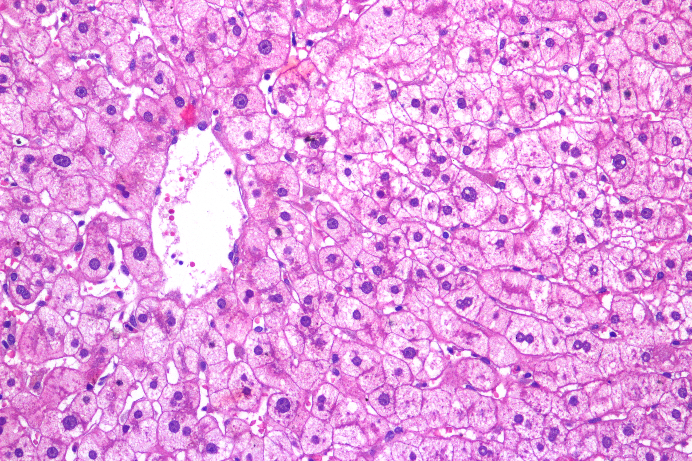
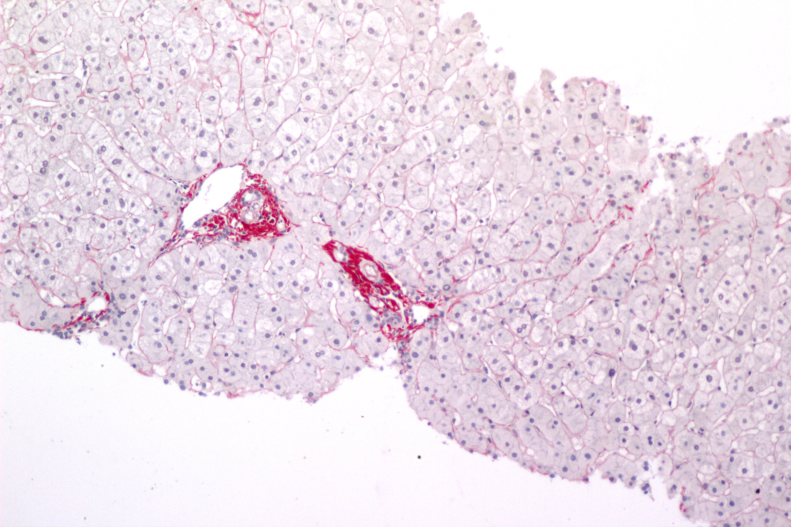
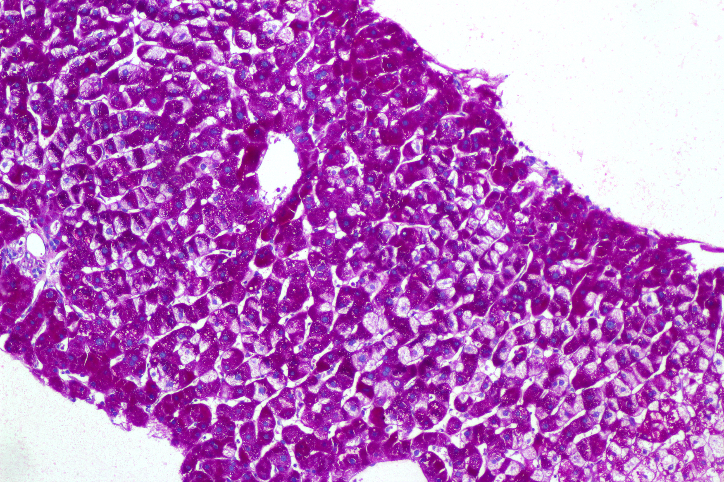
Pathological findings
Notes:
Inflamação portal (intensidade): minima
Natureza das células inflamatórias: células mononucleares
Fibrose portal: mínima em alguns espaços porta
Reação ductular: mínima em poucos espaços porta
Balonização hepatocelular: presente, difusa, discreta com membranas células realçadas, positivas para glicogênio no PAS com diastase
Atividade de interface, Folículos linfoides, Septos fibrosos, Reação ductular, Fibrose perissinusoidal, Congestão, Inflamação no parênquima, Necrose hepatocelular, Apoptose de hepatócitos, Esteatose, Corpúsculos Mallory-Denk, Colestase, Sobrecarga de ferro ausentes.

Slide 10
Pathological findings
Notes:
Inflamação portal (intensidade): minima
Natureza das células inflamatórias: células mononucleares
Fibrose portal: mínima em alguns espaços porta
Reação ductular: mínima em poucos espaços porta
Balonização hepatocelular: presente, difusa, discreta com membranas células realçadas, positivas para glicogênio no PAS com diastase
Atividade de interface, Folículos linfoides, Septos fibrosos, Reação ductular, Fibrose perissinusoidal, Congestão, Inflamação no parênquima, Necrose hepatocelular, Apoptose de hepatócitos, Esteatose, Corpúsculos Mallory-Denk, Colestase, Sobrecarga de ferro ausentes.

Slide 13
Pathological findings
Notes:
Inflamação portal (intensidade): minima
Natureza das células inflamatórias: células mononucleares
Fibrose portal: mínima em alguns espaços porta
Reação ductular: mínima em poucos espaços porta
Balonização hepatocelular: presente, difusa, discreta com membranas células realçadas, positivas para glicogênio no PAS com diastase
Atividade de interface, Folículos linfoides, Septos fibrosos, Reação ductular, Fibrose perissinusoidal, Congestão, Inflamação no parênquima, Necrose hepatocelular, Apoptose de hepatócitos, Esteatose, Corpúsculos Mallory-Denk, Colestase, Sobrecarga de ferro ausentes.

Slide 15
Pathological findings
Notes:
Inflamação portal (intensidade): minima
Natureza das células inflamatórias: células mononucleares
Fibrose portal: mínima em alguns espaços porta
Reação ductular: mínima em poucos espaços porta
Balonização hepatocelular: presente, difusa, discreta com membranas células realçadas, positivas para glicogênio no PAS com diastase
Atividade de interface, Folículos linfoides, Septos fibrosos, Reação ductular, Fibrose perissinusoidal, Congestão, Inflamação no parênquima, Necrose hepatocelular, Apoptose de hepatócitos, Esteatose, Corpúsculos Mallory-Denk, Colestase, Sobrecarga de ferro ausentes.

Slide 18
Pathological findings
Notes:
Inflamação portal (intensidade): minima
Natureza das células inflamatórias: células mononucleares
Fibrose portal: mínima em alguns espaços porta
Reação ductular: mínima em poucos espaços porta
Balonização hepatocelular: presente, difusa, discreta com membranas células realçadas, positivas para glicogênio no PAS com diastase
Atividade de interface, Folículos linfoides, Septos fibrosos, Reação ductular, Fibrose perissinusoidal, Congestão, Inflamação no parênquima, Necrose hepatocelular, Apoptose de hepatócitos, Esteatose, Corpúsculos Mallory-Denk, Colestase, Sobrecarga de ferro ausentes.

Slide 19
Pathological findings
Hepatocytes
Discreet/moderate ballooning
Pale cytoplasm
Accentuation of the cell membranes
No steatosis/inflammation

Slide 20
Final diagnosis
GLYCOGENIC HEPATOPATHY

Slide 21
Discussion
Glycogenic Hepatopathy
First described by Pierre Mauriac, in 1930 (poorly controlled DM 1 patient)
Insulin-dependent
Incidence and prevalence unknown
Female sex
Young age
(Torbenson, 2006)

Slide 22
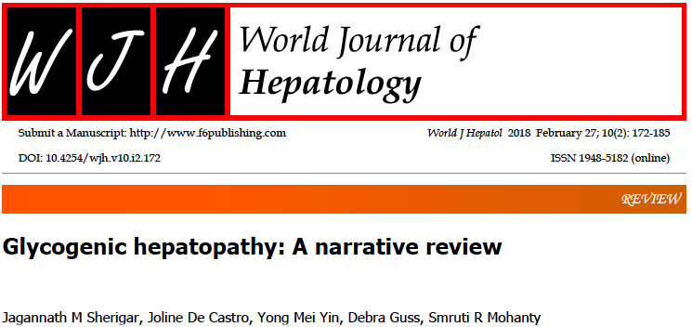
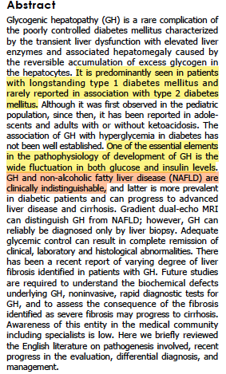
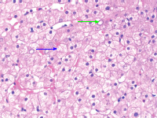

Slide 23
Discussion
Glycogenic Hepatopathy
Fluctuating serum glucose levels + supraphysiological administration of insulin required for condition control
(Torbenson, 2006)

Slide 24
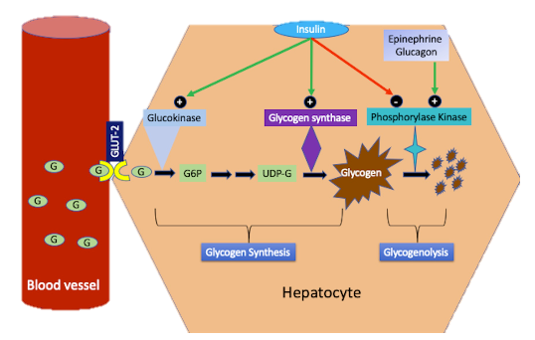
Discussion
Glycogenic Hepatopathy
Fluctuating serum glucose levels + supraphysiological administration of insulin required for condition control
(Torbenson, 2006)
(Yousaf, 2020)

Slide 25
Discussion
Glycogenic Hepatopathy
Poor glycemic control
Clinical triad
↑ Liver enzymes
Hepatomegaly
(Torbenson, 2006)

Slide 26
Discussion
Glycogenic Hepatopathy
Clinical triad
↑ Liver enzymes
Poor glycemic control
Hepatomegaly
Other potential findings
Abdominal pain, nausea or vomiting, ascites, jaundice and itching
↑ Alkaline phosphatase, Amylase, Lipase and Lactate
(Torbenson, 2006)
(Sherigar, 2018)

Slide 27
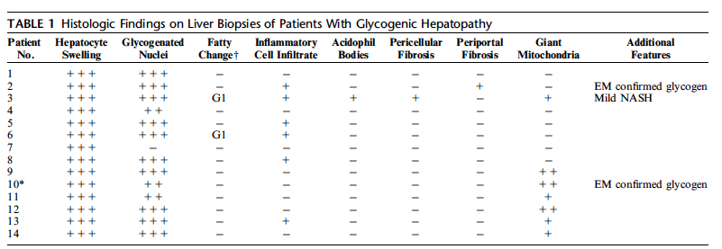
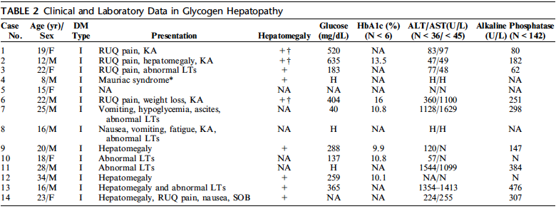
(Am J Surg Pathol 2006;30:508–513)

Slide 28
Discussion
Glycogenic Hepatopathy
Diagnosis
Difficult to diagnose condition
Rule out other conditions
Auxiliary imaging tests: USG, CT, MRI
Definitive diagnosis is made by liver biopsy
(Sherigar, 2018)

Slide 29
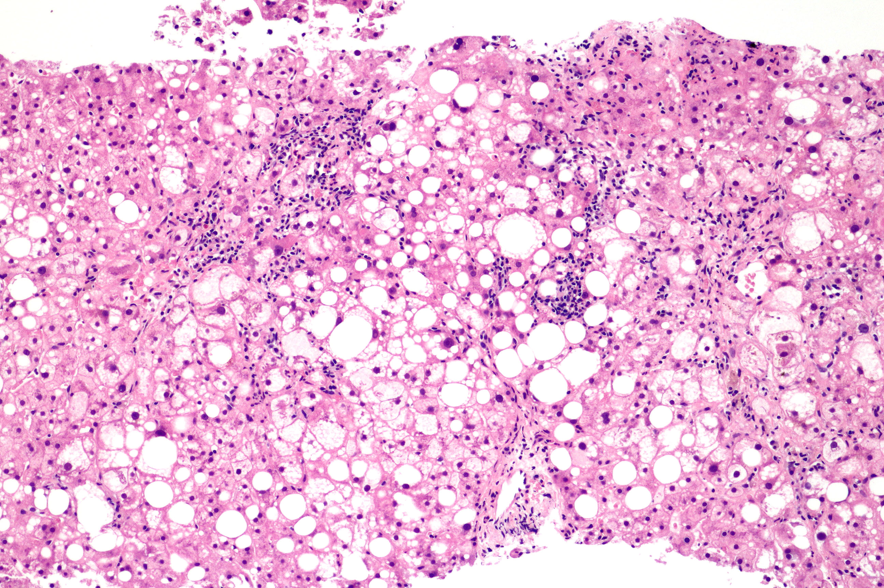
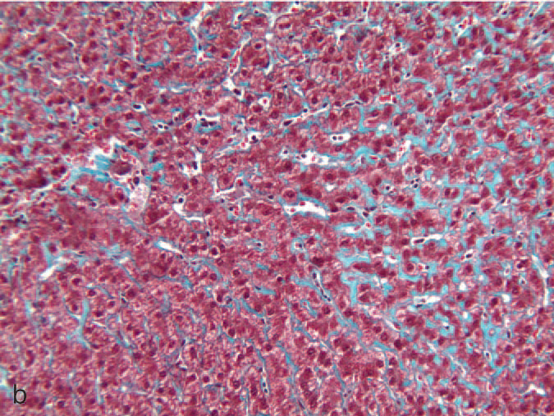
Discussion
Glycogenic Hepatopathy
Differential diagnosis
MASLD
Diabetic Hepatosclerosis
70% of patients with DM
2-12% of patients with DM
(Torbenson, 2006); (Lomonaco, 2021)

Slide 30
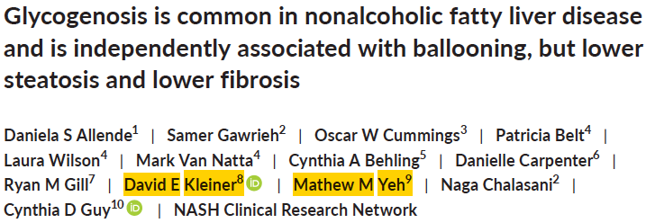
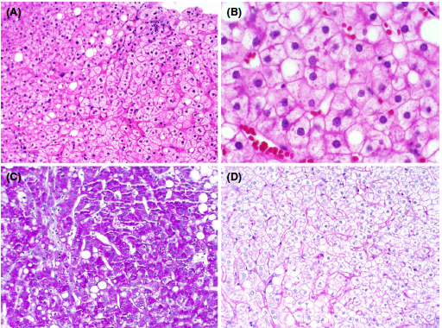
Liver Int. 2021 May;41(5):996-1011. doi: 10.1111/liv.14773.

Slide 31
Follow-up
Discharged on 10/04/24;
Symptoms compensated;
Diagnosed with diabetic nephropathy, severe proliferative diabetic retinopathy, diabetic neuropathy and glycogenic hepatopathy;
Two days after being discharged, she presented once more with progressive edema, abdominal pain in the epigastrium and right hypochondrium, vomiting and fatigue;
She was hospitalized again and needs constant monitoring.

Slide 32
Follow-up
Physical examination:
General Appearence: No signs of discomfort or distress are observed;
Respiratory: Lungs are clear to auscultation bilaterally. No wheezes, rales, or rhonchi. Chest wall is non-tender with normal respiratory effort;
Cardiovascular: Heart sounds are normal with a regular rate and rhythm. No murmurs, rubs, or gallops are heard. Peripheral pulses are 2+ and symmetric;
Abdomen: Abdomen is globose due to adipose tissue. Bowel sounds are present. No hepatosplenomegaly or masses are palpated. No tenderness or guarding;
Skin: Excoriation present in left hypochondrial region.

Slide 33
Follow-up
 | 10/05/24 | 13/05/24 | 21/05/24
HB | 9,3 | 9,7 | 7,4
HT | 27,8% | 28,6% | 23,4%
HbA1c | 5,0% |  | 4,5
Leuco | 5.440 | 5.890 | 9.740
Platelet | 402.000 | 398.000 | 664.000
NA | 141 | 141 | 144
K | 3,5 | 3,3 | 3,4
Urea | 61 | 54 | 91
Creatinne | 1,7 | 1,3
LDL |  | 266
HDL |  | 53
Triglyc. |  | 233
BT | 0,28 | 0,2 | 0,17
AST | 13 | 17 | 28
ALT | 12 | 16 | 41
ALP | 239 | 209 | 243
GGT | 1.614 | 1483 | 1970
NRI |  | 1,03 | 1,0
TTPA |  |  | 29,8
Amylase | 18
Lipase | 4

Slide 34
Clinical timeline
HbA1c 12,4%
ALT
AST
ALP
GGT
Before

Slide 35
Clinical timeline
HbA1c 12,4%
Hepatomegaly
ALP
GGT
ALT
AST
Admission

Slide 36
Clinical timeline
Hepatomegaly
ALP
GGT
ALT
AST
HbA1c 12,4%
HbA1c 5,2%
Evolution

Slide 37
Clinical timeline
ALP
GGT
ALT
AST
HbA1c 4,5%
Without hepatomegaly
Discharge

Slide 38
Discussion
Glycogenic Hepatopathy
Management, prognosis and monitoring
Monitoring metabolic and liver profiles
Strict control of glucose levels
Excellent prognosis with improved glycemic control
(Sherigar, 2018)

Slide 39
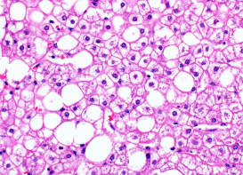
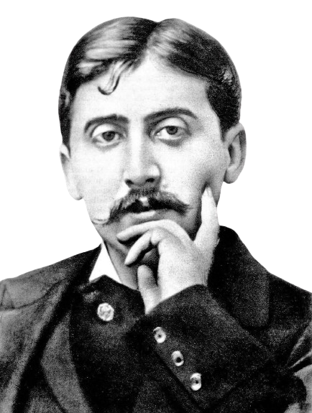
Take home message
“The real voyage of discovery is not about looking for new landscapes, it's about having new eyes”
Marcel Proust
Notes:
“A verdadeira viagem de descobrimento não consiste em procurar novas paisagens e sim em ter novos olhos”

Slide 40
References
Rautou, Pierre–Emmanuel, et al. “Acute Liver Cell Damage in Patients with Anorexia Nervosa: A Possible Role of Starvation-Induced Hepatocyte Autophagy.” Gastroenterology, vol. 135, no. 3, Sept. 2008, pp. 840-848.e3, https://doi.org/10.1053/j.gastro.2008.05.055.
Fujisaki, Noritomo, et al. “Glycogenic Hepatopathy Following Attempted Suicide by Long‐Acting Insulin Overdose in Patient with Type 1 Diabetes.” Journal of the American College of Emergency Physicians Open, vol. 1, no. 5, 25 May 2020, pp. 1097–1100, https://doi.org/10.1002/emp2.12093.
Sherigar, Jagannath M, et al. “Glycogenic Hepatopathy: A Narrative Review.” World Journal of Hepatology, vol. 10, no. 2, 27 Feb. 2018, pp. 172–185, https://doi.org/10.4254/wjh.v10.i2.172.
Van Den Brand, M, et al. Glycogenic Hepatopathy: A Rare Cause of Elevated Serum Transaminases in Diabetes Mellitus. Dec. 2009.
Yousaf M N, Ehsan H, Ehsan S, et al. (July 21, 2020) Glycogenic Hepatopathy: A Reversible Complication of Uncontrolled Diabetes Mellitus. Cureus 12(7): e9323. DOI 10.7759/cureus.9323
Khoury, Johad, et al. “Glycogenic Hepatopathy.” Hepatobiliary & Pancreatic Diseases International, vol. 17, no. 2, Apr. 2018, pp. 113–118, https://doi.org/10.1016/j.hbpd.2018.02.006.
Allende, Daniela S, et al. “Glycogenosis Is Common in Nonalcoholic Fatty Liver Disease and Is Independently Associated with Ballooning, but Lower Steatosis and Lower Fibrosis.” Liver International, vol. 41, no. 5, 7 Jan. 2021, pp. 996–1011, https://doi.org/10.1111/liv.14773.
Torbenson, Michael; Chen, Yunn-Yi; Brunt, Elizabeth; Cummings, Oscar W.; Gottfried, Marcia; Jakate, Shriram; Liu, Yao-Chang; Yeh, Matthew M.; Ferrell, Linda. Glycogenic Hepatopathy: An Underrecognized Hepatic Complication of Diabetes Mellitus. The American Journal of Surgical Pathology 30(4):p 508-513, April 2006.
Lombardo, Fortunato, et al. “Hepatomegaly and Type 1 Diabetes: A Clinical Case of Mauriac’s Syndrome.” Italian Journal of Pediatrics, vol. 45, no. 1, 7 Jan. 2019, https://doi.org/10.1186/s13052-018-0598-2.
Lomonaco, Romina, et al. “Advanced Liver Fibrosis Is Common in Patients with Type 2 Diabetes Followed in the Outpatient Setting: The Need for Systematic Screening.” Diabetes Care, vol. 44, no. 2, 13 Jan. 2021, pp. 399–406, https://doi.org/10.2337/dc20-1997.

Slide 41
Thank you

